Slide 1

Vision control
Source: http://ia-latam.com/2019/01/28/la-ia-se-integrara-en-la-mayoria-de-los-aspectos-de-la-vida-humana/

Slide 2



Project Team
FH-Prof. Dipl.-Ing. Dr. Wolfgang Werth
MSc Heinz-Peter Ulrich Liechtenecker
Gregor Fritz
Laurenz Hundgeburth

Slide 3
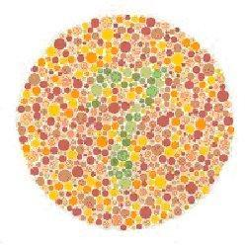
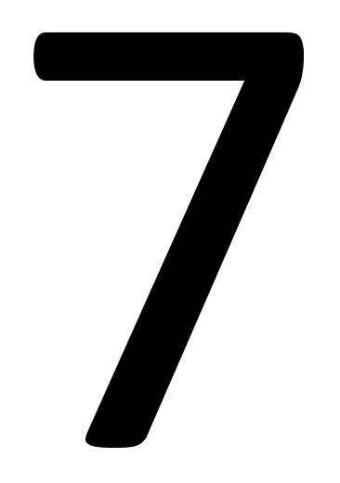
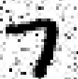
Thought Experiment on Abstraction
Source1: http://www.marcelhaas.com/index.php/author/marcelhaas_em0ahm/
Source2: http://www.uni-koeln.de/~jschween/spiel/farbtafeln/farbtafeln.html

Slide 4
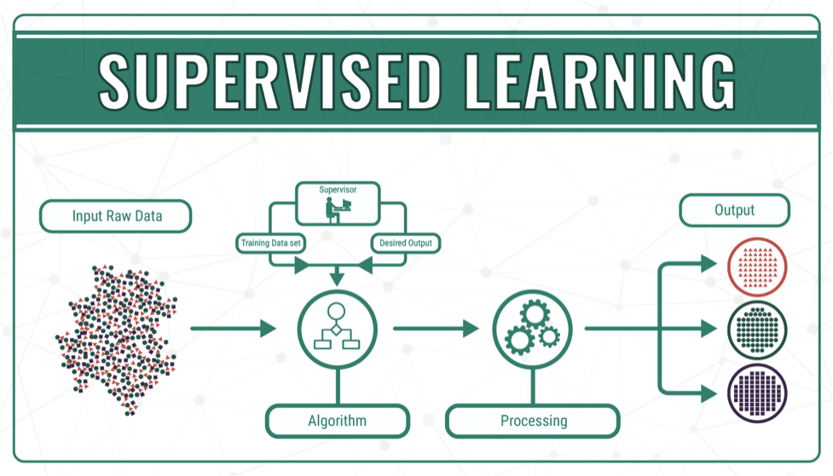
Supervised Learning
Source3: https://medium.com/@himanshuit3036/supervised-learning-methods-using-python-bb85b8c4e0b7

Slide 5
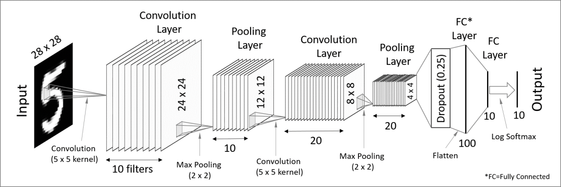
Solution
Convolutional Neural Network
Source 4: https://codetolight.wordpress.com/2017/11/29/getting-started-with-pytorch-for-deep-learning-part-3-neural-network-basics/

Slide 6





Goal
Sensor
Control
Camera
Motor
USB
Motor Power
Motor Encoder
θ
Training
θ
PC
RS232
MCU

Slide 7
A Bit of PM
PM
March
Feasibility Study
April
Camera
September
Data Acquisition
Model Training
Final Tests
Mai
June
August
Time
Budget: 1000€
Microcontroller: FH
Servo Motor: FH
Laptop: personal
Hardware
Camera: 15€
USB-Camera
5 h/week
March - October
Approx. 70h so far
Cost

Slide 8
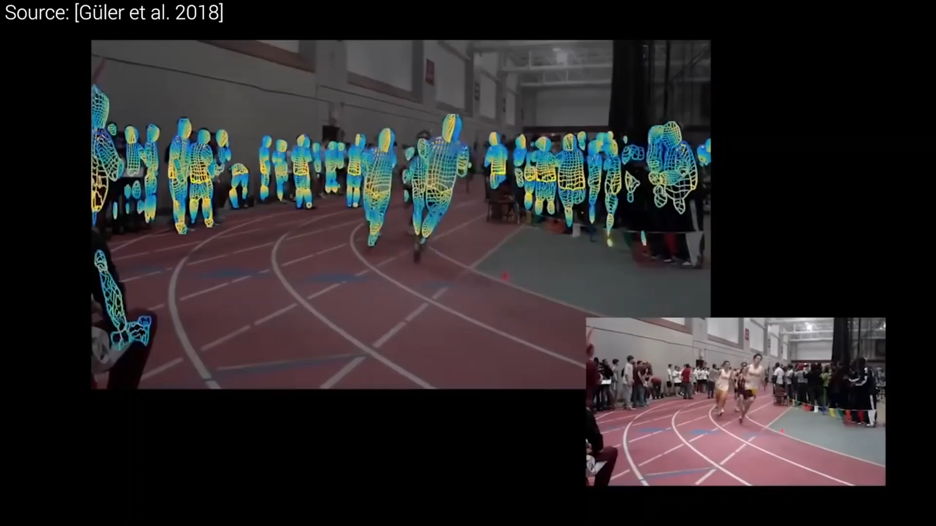
Conclusion
Source5: https://www.youtube.com/watch?v=F84jaIR5Uxc&t=10s

Slide 9
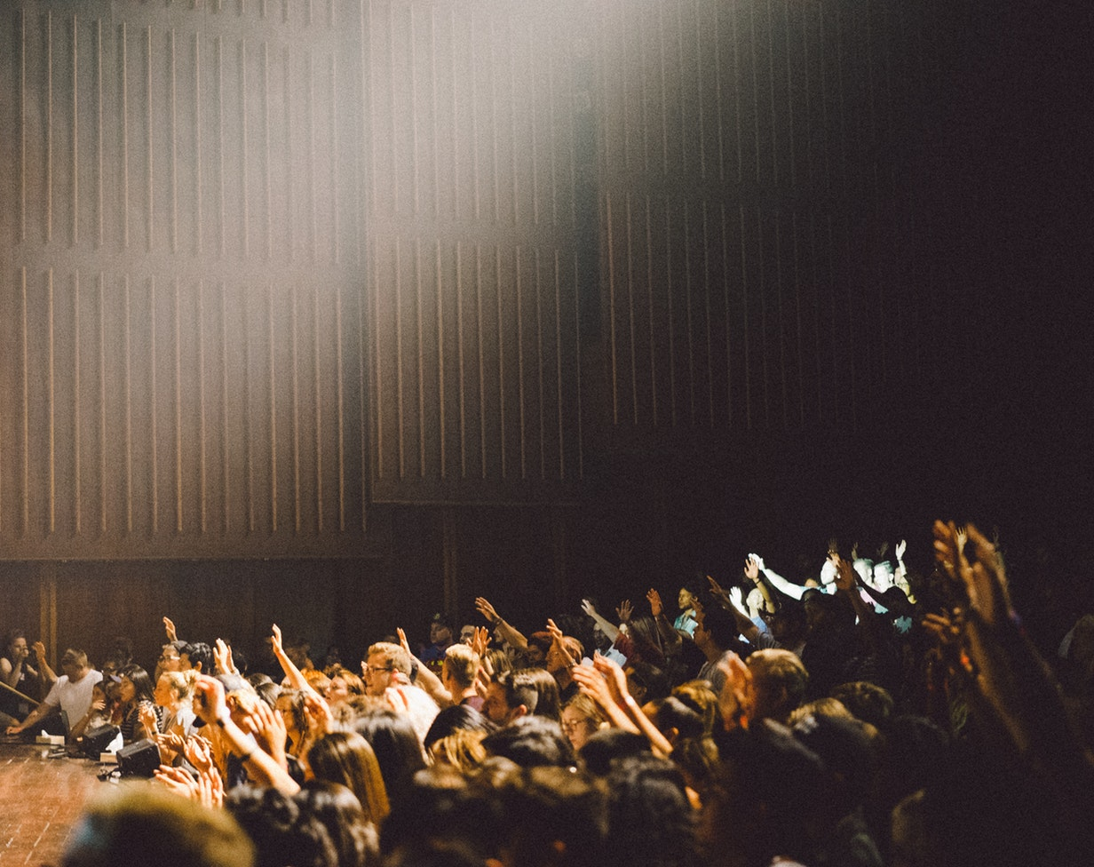
Thank You!

